Slide 1



Noida Institute of Engineering and Technology, Greater Noida
TREES
UNIT-IV
Unit: 4
Data Structures
Alisha Sikri
Assistant Professor
Course Details
(B Tech 3rd Sem)

Slide 2
Content
Tree
  Tree terminology
Binary Tree
  Binary tree representation
  Binary tree traversal
Binary Search tree
Threaded Binary tree
Huffman Coding
AVL Tree
B-Tree

Slide 3
Course Objective
To understand the working of tree data structure.
To understand the applications of tree data structure like data compression using Huffman algorithm.
To understand the limitations of trees and how these limitations are removed.

Slide 4
Course Outcome
CO | CO Description | Bloom’s Knowledge Level (KL)
CO1 | Describe how arrays, linked lists, stacks, queues, trees, and graphs are represented in memory, used by the algorithms and their common applications. | K1, K2
CO2 | Discuss the computational efficiency of the sorting and searching algorithms. | K2
CO3 | Implementation of Trees and Graphs and perform various operations on these data structure. | K3
CO4 | Understanding the concept of recursion, application of recursion and its implementation and removal of recursion. | K4
CO5 | Identify the alternative implementations of data structures with respect to its performance to solve a real world problem. | K5, K6

Slide 5
CO-PO and PSO Mapping
CO-PO correlation matrix of Data Structure (KCS 301)
 | PO1 | PO2 | PO3 | PO4 | PO5 | PO6 | PO7 | PO8 | PO9 | PO10 | PO11 | PO12
KCS301.1 | 3 | 3 | 3 | 2 | - | 1 | - | 1 | 2 | 2 | 2 | 2
KCS301.2 | 3 | 3 | 2 | 2 | - | 1 | - | 1 | 2 | 2 | 1 | 2
KCS301.3 | 3 | 3 | 2 | 2 | - | 1 | - | 1 | 2 | 2 | 2 | 2
KCS301.4 | 3 | 3 | 2 | 2 | - | 1 | - | 1 | 2 | 2 | 2 | 2
KCS301.5 | 3 | 3 | 3 | 3 | 2 | 2 | 2 | 2 | 3 | 3 | 3 | 3
Average | 3 | 3 | 2.4 | 2.2 | 0.4 | 1.2 | 0.4 | 1.2 | 2.2 | 2.2 | 2 | 2.2
Mapping of Program Specific Outcomes and Course Outcomes
 | PSO1 | PSO2 | PSO3 | PSO4
KCS301.1 | 3 | 3 | 2 | 2
KCS301.2 | 3 | 3 | 2 | 3
KCS301.3 | 3 | 3 | 2 | 2
KCS301.4 | 3 | 3 | 3 | 3
KCS301.5 | 3 | 3 | 3 | 3
Average | 3 | 3 | 2.4 | 2.6

Slide 6
Prerequisite and Recap
Knowledge of basics concepts of data structure like searching sorting studied in unit-3.
Mathematical vision to understand the working and application of trees.
Programming skills to implement tree data structure in a programming language.
Recap
  In last unit we studied
    About graphs and their application areas.
    Graph terminology
    Graph representation and traversal
    Minimum Spanning Trees
    Warshall Algorithm

Slide 7
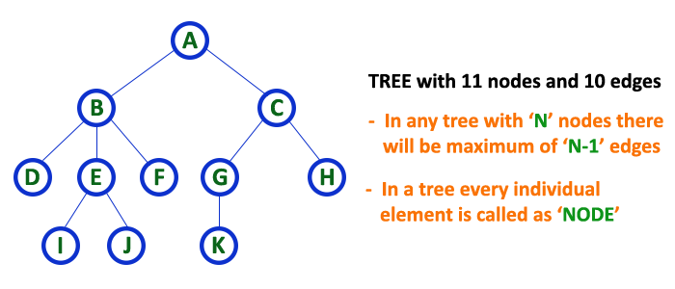
Tree (CO3)
A tree is a very popular non-linear data structure used in a wide range of applications. A tree data structure can be defined as follows...
  Tree is a non-linear data structure which organizes data in hierarchical structure and this is a recursive definition.
  OR
  Tree data structure is a collection of data (Node) which is organized in hierarchical structure recursively
In tree data structure, every individual element is called as Node
In a tree data structure, if we have N number of nodes then we can have a maximum of N-1 number of links.
  Example:-

Slide 8
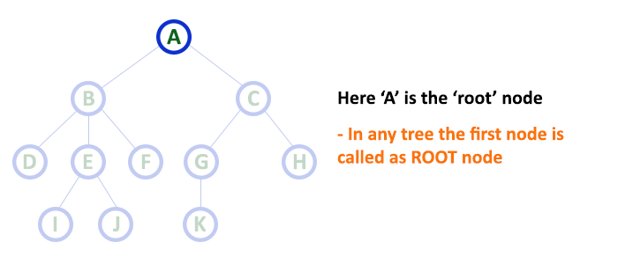
Tree Terminology
Root
  In a tree data structure, the first node is called as Root Node.
  Every tree must have a root node.
  Root node is the origin of the tree data structure.
  In any tree, there must be only one root node.

Slide 9
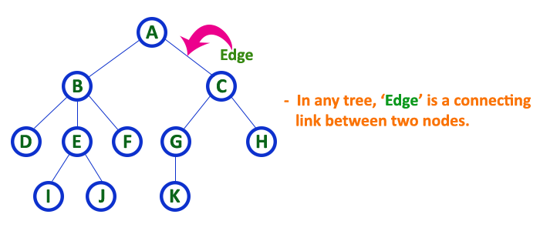
Tree Terminology
Edge
  In a tree data structure, the connecting link between any two nodes is called as EDGE.
  In a tree with 'N' number of nodes there will be a maximum of 'N-1' number of edges.

Slide 10
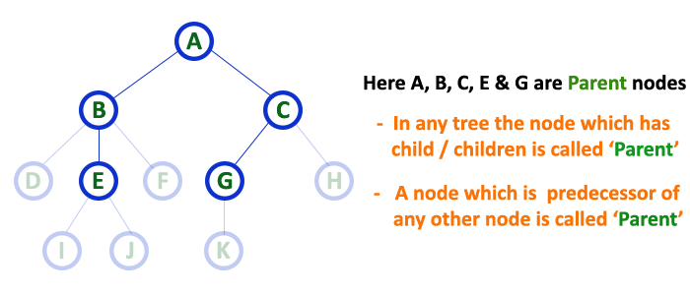
Tree Terminology
Parent
  In a tree data structure, the node which is a predecessor of any node is called as PARENT NODE.
  In simple words, the node which has a branch from it to any other node is called a parent node.
  Parent node can also be defined as "The node which has child / children".

Slide 11
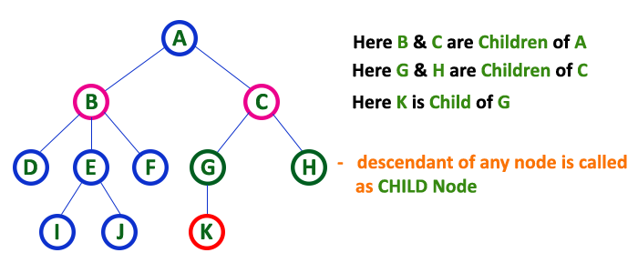
Tree Terminology
Child
  In a tree data structure, the node which is descendant of any node is called as CHILD Node.
  In simple words, the node which has a link from its parent node is called as child node.
  In a tree, any parent node can have any number of child nodes.
  In a tree, all the nodes except root are child nodes.

Slide 12
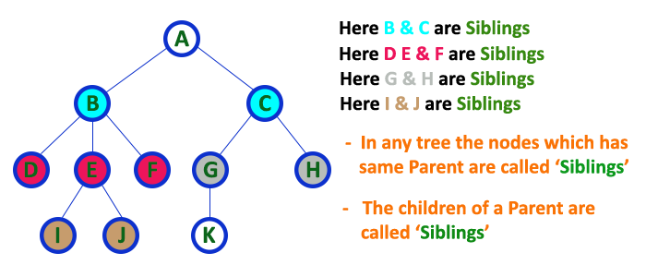
Tree Terminology
Siblings
  In a tree data structure, nodes which belong to same Parent are called as SIBLINGS.
  In simple words, the nodes with the same parent are called Sibling nodes

Slide 13
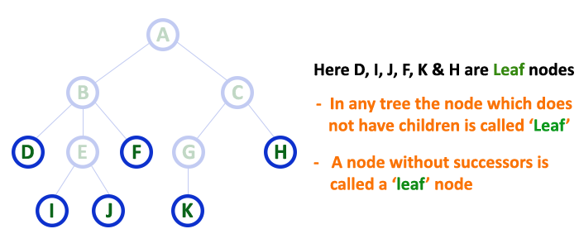
Tree Terminology
Leaf
  In a tree data structure, the node which does not have a child is called as LEAF Node.
  In simple words, a leaf is a node with no child.
  In a tree data structure, the leaf nodes are also called as External Nodes.
  In a tree, leaf node is also called as 'Terminal' node.

Slide 14
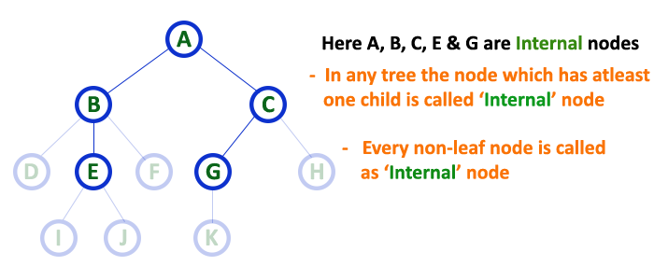
Tree Terminology
Internal Nodes
  In a tree data structure, the node which has atleast one child is called as INTERNAL Node.
  In a tree data structure, nodes other than leaf nodes are called as Internal Nodes.
  The root node is also said to be Internal Node if the tree has more than one node.
  Internal nodes are also called as 'Non-Terminal' nodes.

Slide 15
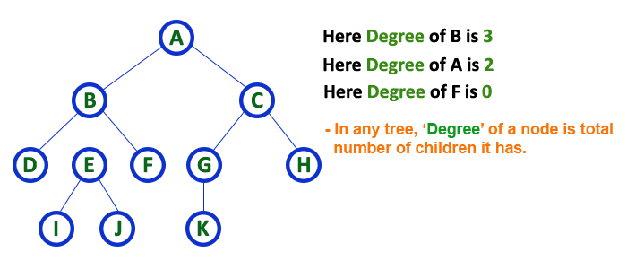
Tree Terminology
Degree
  In a tree data structure, the total number of children of a node is called as DEGREE of that Node.
  The highest degree of a node among all the nodes in a tree is called as 'Degree of Tree'

Slide 16
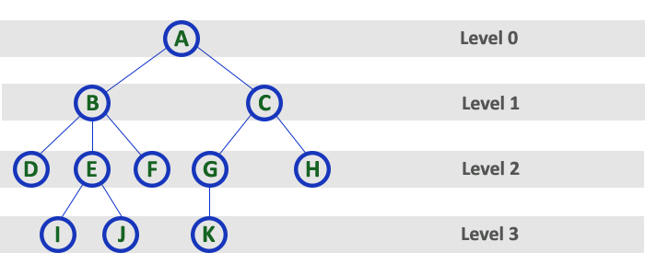
Tree Terminology
Level
  In a tree data structure, the root node is said to be at Level 0 and the children of root node are at Level 1 and the children of the nodes which are at Level 1 will be at Level 2 and so on...
  In simple words, in a tree each step from top to bottom is called as a Level and the Level count starts with '0' and incremented by one at each level (Step).

Slide 17
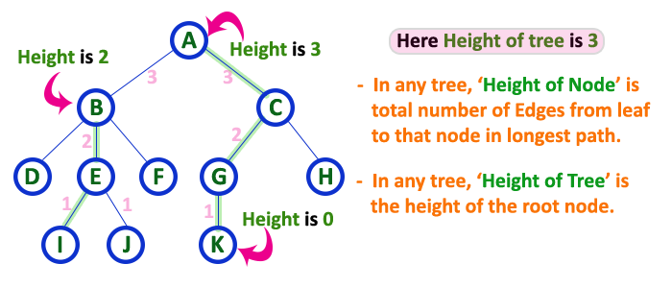
Tree Terminology
Height
  In a tree data structure, the total number of edges from leaf node to a particular node in the longest path is called as HEIGHT of that Node.
  In a tree, height of the root node is said to be height of the tree.
  In a tree, height of all leaf nodes is '0'.

Slide 18
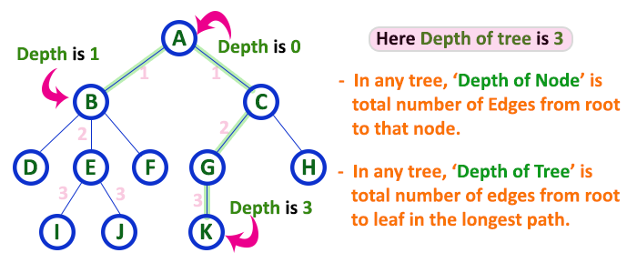
Tree Terminology
Depth
  In a tree data structure, the total number of egdes from root node to a particular node is called as DEPTH of that Node.
  In a tree, the total number of edges from root node to a leaf node in the longest path is said to be Depth of the tree.
  In a tree, depth of the root node is '0'.

Slide 19
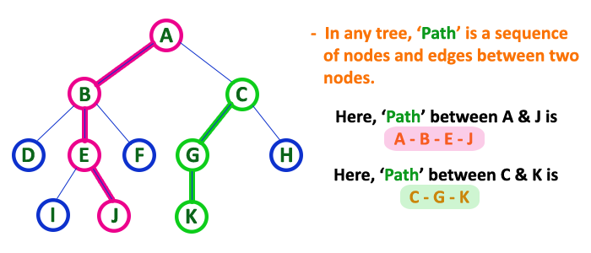
Tree Terminology
Path
  In a tree data structure, the sequence of Nodes and Edges from one node to another node is called as PATH between that two Nodes.
  Length of a Path is total number of nodes in that path.
  In below example the path A - B - E - J has length 4.

Slide 20
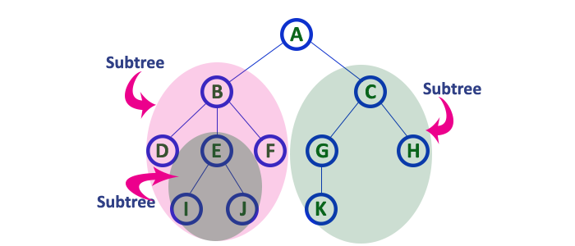
Tree Terminology
Sub Tree
  In a tree data structure, each child from a node forms a subtree recursively.
  Every child node will form a subtree on its parent node.

Slide 21
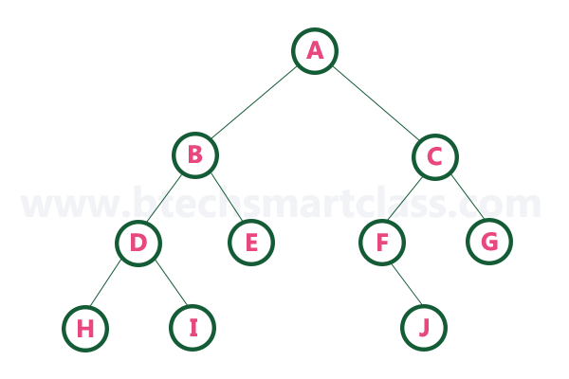
Binary Tree (CO3)
In a normal tree, every node can have any number of children.
A binary tree is a special type of tree data structure in which every node can have a maximum of 2 children.
One is known as a left child and the other is known as right child.
A tree in which every node can have a maximum of two children is called Binary Tree.
In a binary tree, every node can have either 0 children or 1 child or 2 children but not more than 2 children.
  Example

Slide 22
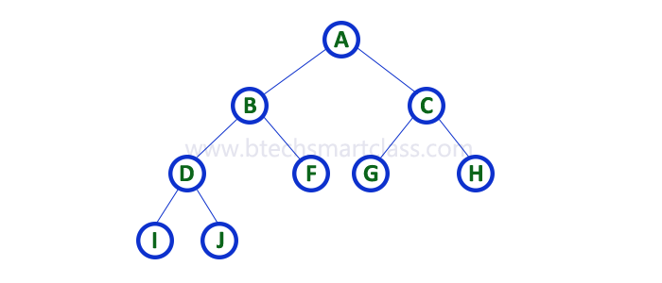
Binary Tree
Strictly Binary Tree
  A binary tree in which every node has either two or zero number of children is called Strictly Binary Tree
  Strictly binary tree is also called as Full Binary Tree or Proper Binary Tree or 2-Tree

Slide 23
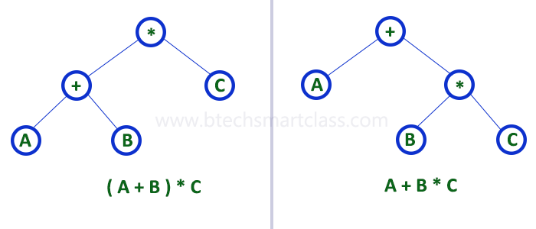
Binary Tree
Strictly binary tree data structure is used to represent mathematical expressions.

Slide 24
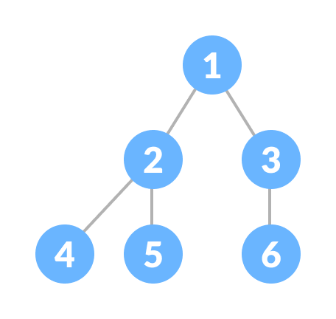
Binary Tree
Complete Binary Tree
  A complete binary tree is a binary tree in which all the levels are completely filled except possibly the lowest one, which is filled from the left.
  A complete binary tree is just like a full binary tree, but with two major differences
    All the leaf elements must lean towards the left.
    The last leaf element might not have a right sibling i.e. a complete binary tree doesn't have to be a full binary tree.

Slide 25
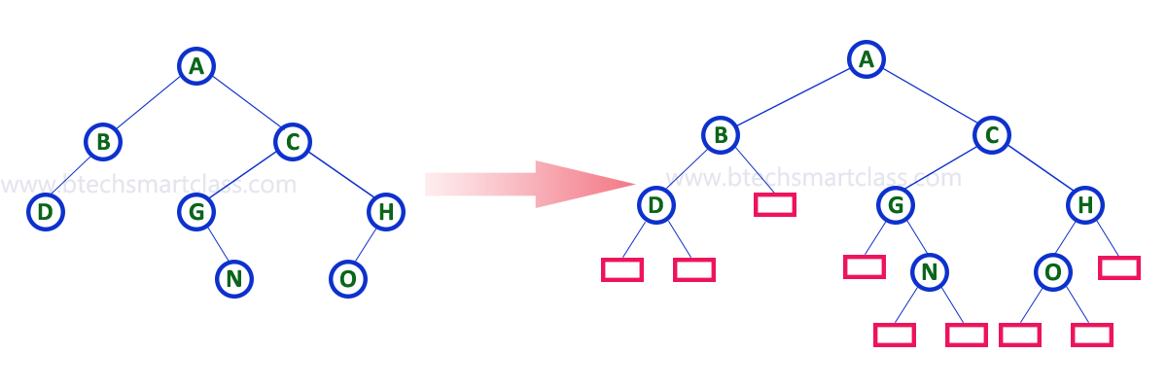
Binary Tree
Extended Binary Tree
  The full binary tree obtained by adding dummy nodes to a binary tree is called as Extended Binary Tree.

Slide 26
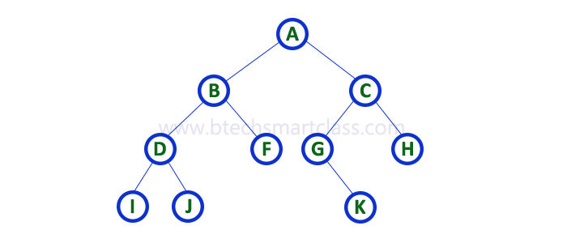
Binary Tree Representation (CO3)
A binary tree data structure is represented using two methods. Those methods are as follows...
  Array Representation
  Linked List Representation
Consider the following binary tree...

Slide 27

Binary Tree Representation
Array Representation of Binary Tree
  In array representation of a binary tree, we use one-dimensional array (1-D Array) to represent a binary tree.
  Consider the above example of a binary tree and it is represented as follows...
  To represent a binary tree of depth 'n' using array representation, we need one dimensional array with a maximum size of 2n + 1.

Slide 28

Binary Tree Representation
Linked List Representation of Binary Tree
  We use a double linked list to represent a binary tree.
  In a double linked list, every node consists of three fields.
  First field for storing left child address, second for storing actual data and third for storing right child address.
  In this linked list representation, a node has the following structure...

Slide 29
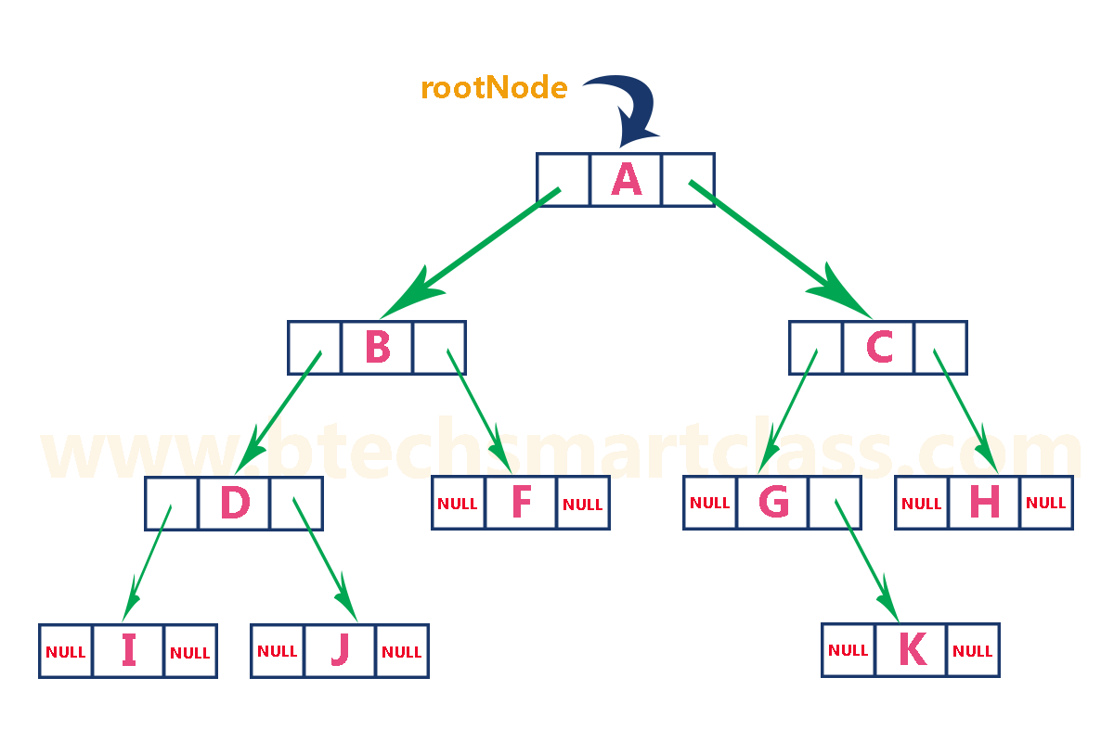
Binary Tree Representation
Linked List Representation of Binary Tree (contd..)
  The above example of the binary tree represented using Linked list representation is shown as follows...

Slide 30
Binary Tree Traversal (CO3)
Displaying (or) visiting order of nodes in a binary tree is called as Binary Tree Traversal.
There are three types of binary tree traversals.
  In - Order Traversal
  Pre - Order Traversal
  Post - Order Traversal
Consider the following binary tree...

Slide 31
Binary Tree Traversal
In - Order Traversal ( leftChild - root - rightChild )
  In In-Order traversal, the root node is visited between the left child and right child.
  In this traversal, the left child node is visited first, then the root node is visited and later we go for visiting the right child node.
  This in-order traversal is applicable for every root node of all subtrees in the tree.
  This is performed recursively for all nodes in the tree
  That means here we have visited in the order of I - D - J - B - F - A - G - K - C - H using In-Order Traversal.
  In-Order Traversal for above example of binary tree is
  I - D - J - B - F - A - G - K - C - H

Slide 32
Binary Tree Traversal
Pre - Order Traversal ( root - leftChild - rightChild )
  In Pre-Order traversal, the root node is visited before the left child and right child nodes.
  In this traversal, the root node is visited first, then its left child and later its right child.
  This pre-order traversal is applicable for every root node of all subtrees in the tree.
  That means here we have visited in the order of A-B-D-I-J-F-C-G-K-H using Pre-Order Traversal.
  Pre-Order Traversal for above example binary tree is
  A - B - D - I - J - F - C - G - K - H

Slide 33
Binary Tree Traversal
Post - Order Traversal ( leftChild - rightChild - root )
  In Post-Order traversal, the root node is visited after left child and right child.
  In this traversal, left child node is visited first, then its right child and then its root node.
  This is recursively performed until the right most node is visited.
  Here we have visited in the order of I - J - D - F - B - K - G - H - C - A using Post-Order Traversal.
  Post-Order Traversal for above example binary tree is
  I - J - D - F - B - K - G - H - C - A

Slide 34
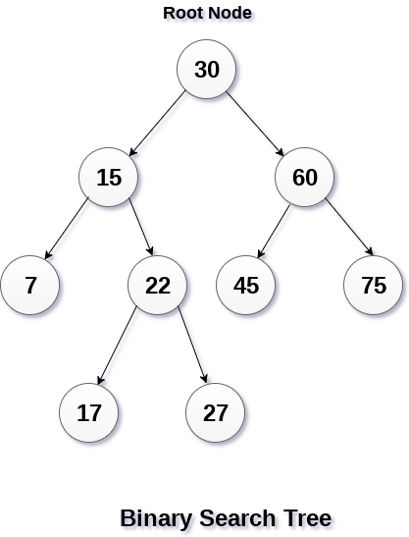
Binary Search Tree (CO3)
Binary Search or ordered binary tree can be defined as a class of binary trees, in which the nodes are arranged in a specific order
In a binary search tree, the value of all the nodes in the left sub-tree is less than the value of the root.
Similarly, value of all the nodes in the right sub-tree is greater than or equal to the value of the root.
This rule will be recursively applied to all the left and right sub-trees of the root.

Slide 35
Binary Search Tree
Advantages of using binary search tree
  Searching become very efficient in a binary search tree since, we get a hint at each step, about which sub-tree contains the desired element.
  The binary search tree is considered as efficient data structure in compare to arrays and linked lists.
  In searching process, it removes half sub-tree at every step. Searching for an element in a binary search tree takes o(log₂n) time. In worst case, the time it takes to search an element is 0(n).
  It also speed up the insertion and deletion operations as compare to that in array and linked list.

Slide 36
Binary Search Tree
Creation or Insetion of binary search tree
  Create the binary search tree using the following data elements.
  43, 10, 79, 90, 12, 54, 11, 9, 50
  Insert 43 into the tree as the root of the tree.
  Read the next element, if it is lesser than the root node element, insert it as the root of the left sub-tree.
  Otherwise, insert it as the root of the right of the right sub-tree.
The process of creating BST by using the given elements, is shown in next slide

Slide 37
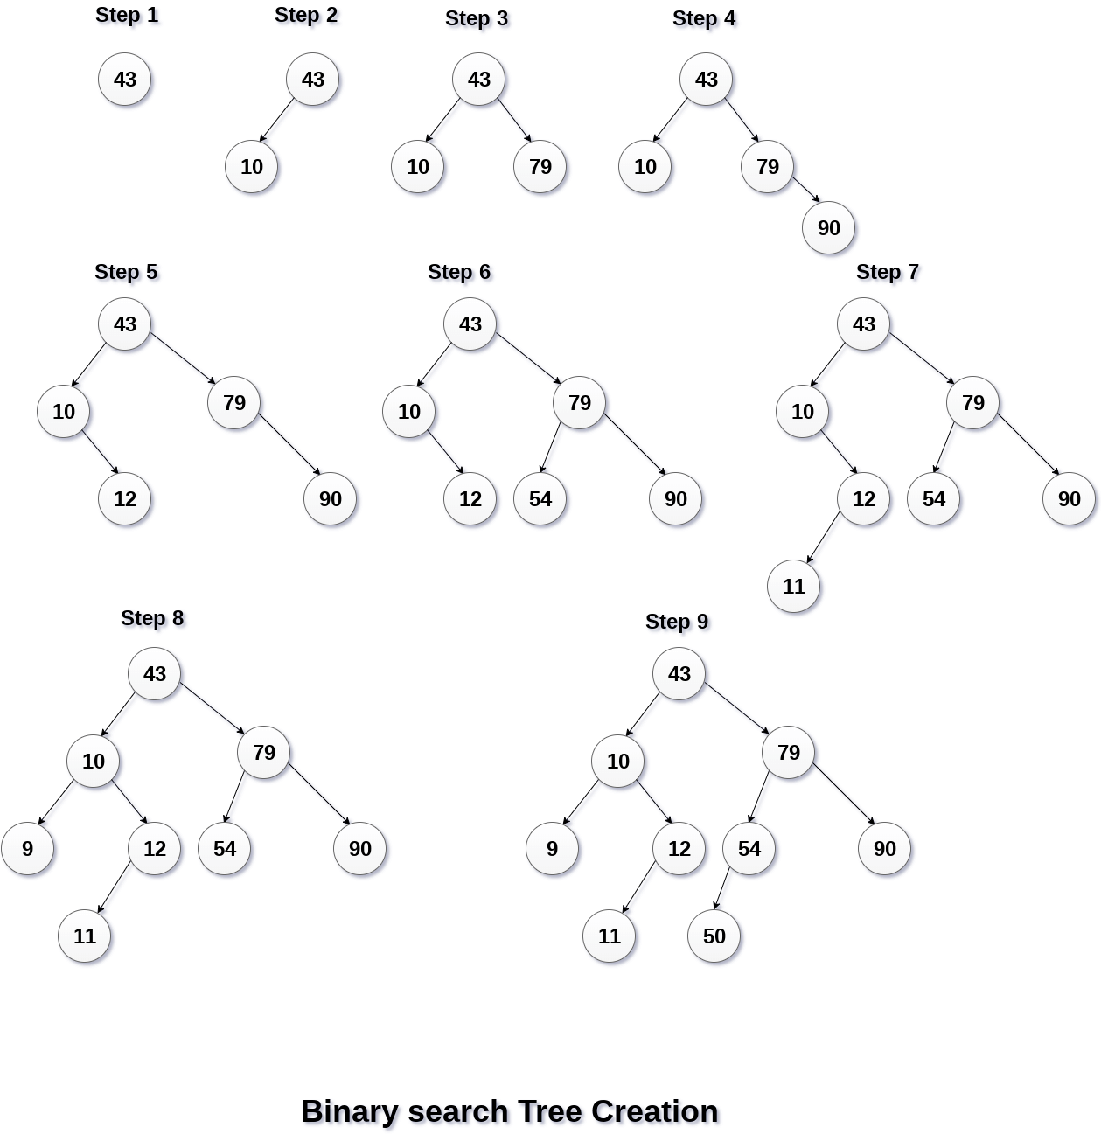
Binary Search Tree
Creation or Insetion of binary search tree (contd..)

Slide 38
Binary Search Tree
Operations on Binary Search Tree
SN | Operation | Description
1 | Searching in BST | Finding the location of some specific element in a binary search tree.
2 | Insertion in BST | Adding a new element to the binary search tree at the appropriate location so that the property of BST do not violate.
3 | Deletion in BST | Deleting some specific node from a binary search tree. However, there can be various cases in deletion depending upon the number of children, the node have.

Slide 39
Threaded Binary Tree (CO3)
In a threaded binary tree, NULL pointers are replaced by references of other nodes in the tree. These extra references are called as threads.
Threaded Binary Tree is also a binary tree in which all left child pointers that are NULL (in Linked list representation) points to its in-order predecessor, and all right child pointers that are NULL (in Linked list representation) points to its in-order successor.
If there is no in-order predecessor or in-order successor, then it points to the root node.
Consider the following binary tree...

Slide 40
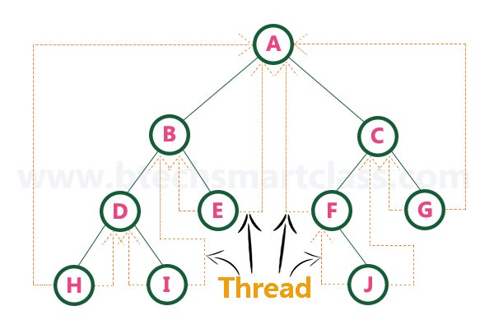
Threaded Binary Tree (contd..)
To convert the above example binary tree into a threaded binary tree, first find the in-order traversal of that tree...
In-order traversal of above binary tree...
  H - D - I - B - E - A - F - J - C - G

Slide 41
AVL Tree
AVL tree is a binary search tree in which the difference of heights of left and right sub trees of any node is less than or equal to one.

Slide 42
AVL Tree
14
11
17
7
53
4
AVL Tree Example:
Insert 14, 17, 11, 7, 53, 4, 13 into an empty AVL tree

Slide 43
AVL Tree
AVL Tree Example:
Insert 14, 17, 11, 7, 53, 4, 13 into an empty AVL tree
14
7
17
4
11
53
13

Slide 44
AVL Tree
AVL Tree Example:
Now insert 12
14
7
17
4
11
53
13
12

Slide 45
AVL Tree
AVL Tree Example:
Now insert 12
14
7
17
4
11
53
12
13

Slide 46
AVL Tree
AVL Tree Example:
Now the AVL tree is balanced.
14
7
17
4
12
53
11
13

Slide 47
AVL Tree
AVL Tree Example:
Now insert 8
14
7
17
4
12
53
11
13
8

Slide 48
AVL Tree
AVL Tree Example:
Now insert 8
14
7
17
4
11
53
8
12
13

Slide 49
AVL Tree
AVL Tree Example:
Now the AVL tree is balanced.
14
11
17
7
12
53
4
8
13

Slide 50
AVL Tree
AVL Tree Example:
Now remove 53
14
11
17
7
12
53
4
8
13

Slide 51
AVL Tree
AVL Tree Example:
Now remove 53, unbalanced
14
11
17
7
12
4
8
13

Slide 52
AVL Tree
AVL Tree Example:
Balanced! Remove 11
11
7
14
4
8
12
17
13

Slide 53
AVL Tree
AVL Tree Example:
Remove 11, replace it with the largest in its left branch
8
7
14
4
12
17
13

Slide 54
AVL Tree
AVL Tree Example:
Remove 8, unbalanced
7
4
14
12
17
13

Slide 55
AVL Tree
AVL Tree Example:
Remove 8, unbalanced
7
4
12
14
13
17

Slide 56
AVL Tree
AVL Tree Example:
Balanced!!
12
7
14
4
13
17

Slide 57
Video Links
Huffman coding
AVL Tree
B tree

Slide 58
Faculty Video Links, Youtube & NPTEL Video Links and Online Courses Details
Youtube/other Video Links
Binary tree traversal
    https://www.youtube.com/watch?v=e_Wv_pH4Se8
Constructing binary tree from inorder, postorder
  https://www.youtube.com/watch?v=s5XRtcud35E
Constructing binary tree from inorder, preorder
  https://www.youtube.com/watch?v=PoBGyrIWisE
Huffman Coding
  https://www.youtube.com/watch?v=saofdNsZiYY
AVL Tree
  https://www.youtube.com/watch?v=_8qqlVH5NC0
B-tree
  https://www.youtube.com/watch?v=aNU9XYYCHu8

Slide 59
Weekly Assignment
Define tree data structure with its terminologies.
Construct expression tree for the following expressions
  A + (B * (C / D) )
  (a + b*c) * ( d + e)
Write the Huffman Algorithm
Prove that the number of leaves in a non-empty full binary tree is one more than the number of internal nodes.
Construct a binary tree if the in-order and post-order traversal is given
Construct a binary tree if the in-order and pre-order traversal is given
  Inorder : 10, 15, 17, 18, 20, 25, 30, 35, 38, 40, 50
  Preorder: 20, 15, 10, 18, 17, 30, 25, 40, 35, 38, 50

Slide 60
MCQ s
The number of edges from the root to the node is called __________ of the tree.
a) Height
b) Depth
c) Length
d) Width
What is a full binary tree?
a) Each node has exactly zero or two children
b) Each node has exactly two children
c) All the leaves are at the same level
d) Each node has exactly one or two children

Slide 61
MCQ s
Which of the following is incorrect with respect to binary trees?
a) Let T be a binary tree. For every k ≥ 0, there are no more than 2k nodes in level k
b) Let T be a binary tree with λ levels. Then T has no more than 2^{λ – 1} nodes
c) Let T be a binary tree with N nodes. Then the number of levels is at least ceil(log (N + 1))
d) Let T be a binary tree with N nodes. Then the number of levels is at least floor(log (N + 1))
Which of the following is not an advantage of trees?
a) Hierarchical structure
b) Faster search
c) Router algorithms
d) Undo/Redo operations in a notepad

Slide 62
Old Question Papers
http://www.aktuonline.com/papers/btech-cs-3-sem-data-structures-kcs301-2020.html
http://www.aktuonline.com/papers/btech-cs-3-sem-data-structures-rcs-305-2018-19.html
http://www.aktuonline.com/papers/btech-cs-3-sem-data-structures-rcs-305-2017-18.html
http://www.aktuonline.com/papers/btech-cs-3-sem-data-structures-using-c-ncs-301-2016-17.html

Slide 63
Expected Questions for University Exam
Define extended binary tree, full binary tree, strictly binary tree and complete binary tree.
Explain threaded binary tree.
Can you find a unique tree when any two traversals are given? Using the following traversals construct the corresponding binary tree:
  INORDER: H K D B I L E A F C M J G
  PREORDER: A B D H K E I L C F G J M
Also find the Post Order traversal of obtained tree.
What is a B-Tree? Generate a B-Tree of order 4 with the alphabets (letters) arrive in the sequence as follows: a g f b k d h m j e s i r x c l n t u p
Draw a binary Tree for the expression: A * B - (C + D) * (P /Q)

Slide 64
Expected Questions for University Exam
Explain Huffman algorithm. Construct Huffman tree for MAHARASHTRA with its optimal code.
What is a height balanced Tree? Why height balancing of Tree is required? Create an AVL Tree for the following elements: a, z, b, y, c, x, d, w, e, v, f
Construct a B-tree of order 5 created by inserting the following elements 3, 14, 7, 1, 8, 5, 11, 17, 13, 6, 23, 12, 20, 26, 4, 16, 18, 24, 25, 19 Also delete elements 6, 23 and 3 from the constructed tree

Slide 65
Summary
Knowledge of tree terminology and different types of trees.
Knowledge of application areas of trees.
Limitation of different trees and how those limitations are removed

Slide 66
References
Aaron M. Tenenbaum, Yedidyah Langsam and Moshe J. Augenstein, “Data Structures Using C and C++”, PHI Learning Private Limited, Delhi India
Horowitz and Sahani, “Fundamentals of Data Structures”, Galgotia Publications Pvt Ltd Delhi India.
Lipschutz, “Data Structures” Schaum’s Outline Series, Tata McGraw-hill Education (India) Pvt. Ltd.
Thareja, “Data Structure Using C” Oxford Higher Education.
AK Sharma, “Data Structure Using C”, Pearson Education India.
Michael T. Goodrich, Roberto Tamassia, David M. Mount “Data Structures and Algorithms in C++”, Wiley India.
. P. S. Deshpandey, “C and Data structure”, Wiley Dreamtech Publication.

Slide 67
Thank You

